Slide 1
Estimating Credit Risk of Individuals
By Tchuissi Mbu Nyamsi, Seun Odibo, Adam Afilaka

Slide 2
Research Question
A functional economy is built on the availability of financing for business and personal activity. However, banks need to consider the possibility that individuals may not make credit payments at agreed upon times.
How can we predict the risk of defaulting on payments for new credit card applicants?

Slide 3
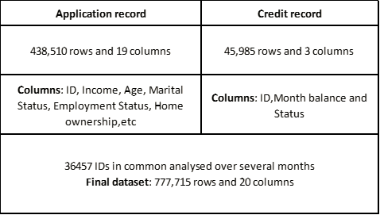
Data : Kaggle datasets
8 Status (labels):
0: 1-29 days past due
1: 30-59 days past due
2: 60-89 days overdue
3: 90-119 days overdue
4: 120-149 days overdue
5: Overdue or bad debts,
write-offs for more than
150 days
C: paid off that month
X: No loan for the month

Slide 4
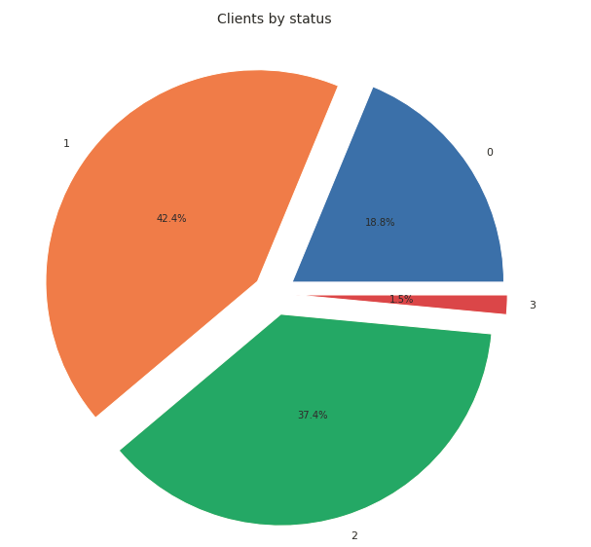
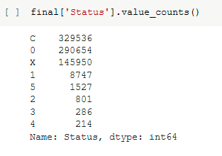
Class labels grouping
How are the class labels distributed in the dataset?
X--> 0 :no loan for the month
C--> 1 :paid off that month
0--> 2 :1-29 days past due
1,2,3,4,5--> 3 :30-59 days past due
Notes:
Most of the clients paid their debt within the month (42,4%)
More than a third paid their debt the following month
Almost one quarter don't have monthly loan (maybe they use only debit card?)
Very few pay their debts after two months (<1.5%)

Slide 5

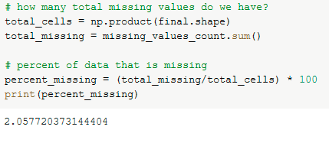
Data Cleaning (EDA)
Rename the columns
Remove irrelevant features such as phone number and emails
Remove rows with missing values: 240,048 rows had missing values for the “Occupation” feature (2% of data missing)

Slide 6
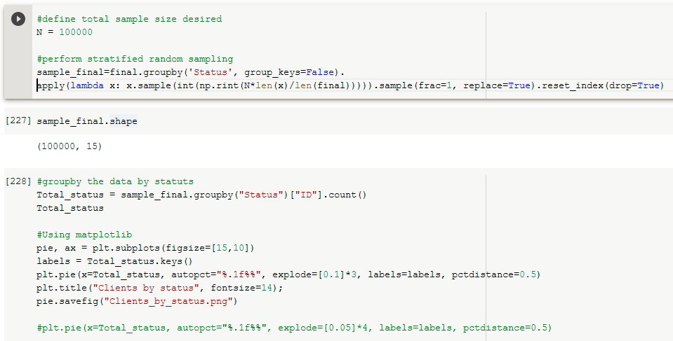
Stratified random sampling
We want to keep the same proportions of class labels as the original to test our model with different sample sizes.

Slide 7
Data Encoding
We have three binary features: gender (M/F) , car and property (Y/N)
We clean three categorical data into binary features:
- Education level: higher or secondary
- Family status : married or single
- Housing type : house or apartment
We clean two categorical features to have only three classes.
- Income type: working, student or retired
- Occupation: low-skill, medium-skill or high-skill staff
We applied one-hot-encoding method for those features
We split our dataset : 80% for training and 20% for testing
We standardized the training features
We are ready to train our model !

Slide 8
Model Estimation and Selection
Models Estimated: Logistic Regression, Random Forest Classifier, Support Vector Classifier
Feature Reduction: Random Forest feature selection, LDA, PCA, KPCA
Parameters Hyper-tuned:
Logistic Regression: Regularization parameter
Random Forest Classifier: maximum depth, number of estimators
Support Vector Classifier: Gamma, Kernel, Regularization parameter
Nested grid search was used to hypertune parameters

Slide 9
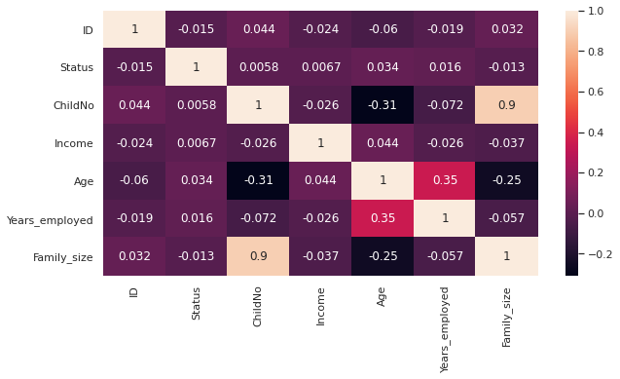
Feature Selection

Slide 10
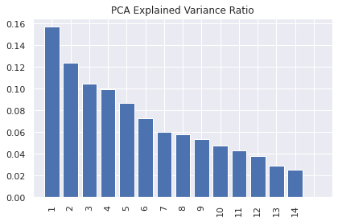
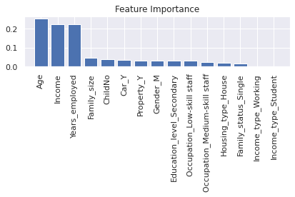
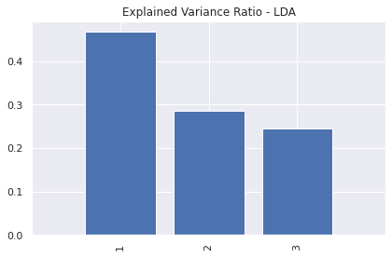
Feature Selection
KCPA was also considered as a feature reduction technique

Slide 11
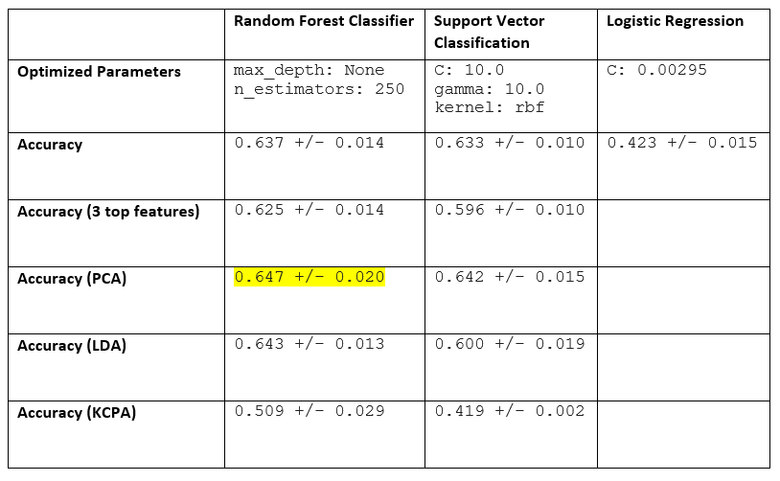
Model Performance
Performance of the best model
With and without Feature Selection
With and without LDA and PCA

Slide 12
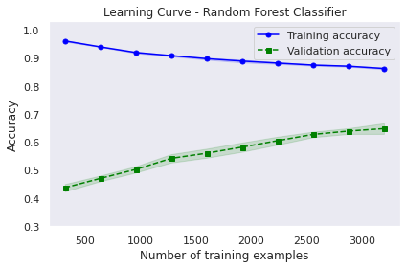
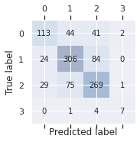
Model Performance

Slide 13
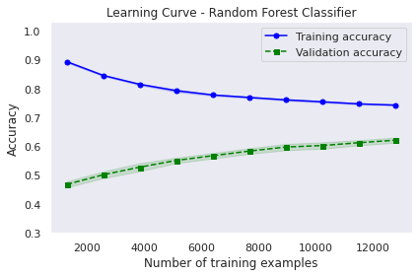
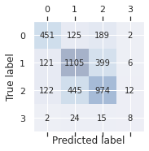
Model Performance
Increased Sample to 20000. Accuracy - 0.623 +/- 0.009

Slide 14
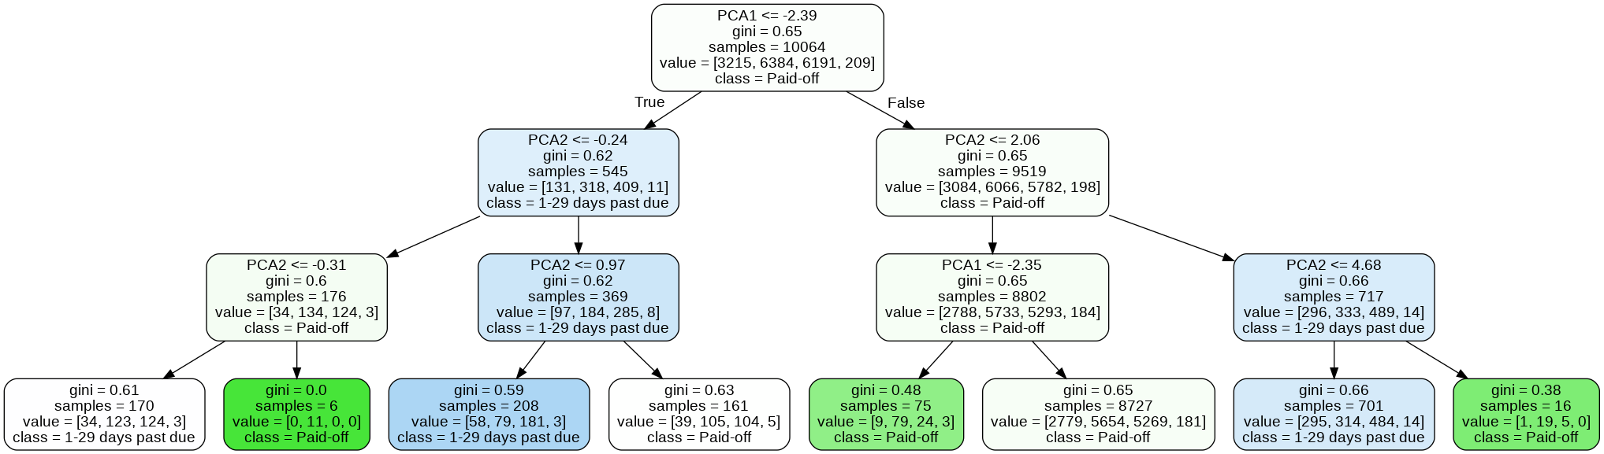
Single Decision Tree from Random Forest

Slide 15
Conclusion
Models performed poorly, even after fine-tuning and feature reduction
Learning curve suggests overfitting
Most features were categorical. The three most important features were the only non-categorical features, except for number of children, which has a limited range of values
Complexity did not seem to be the issue since performance reduced when only three features were used
More relevant features with more variation may be considered for better performance
A larger range of models could also be considered for better performance

Slide 16
Reference
Kaggle source: Kaggle credit card approval dataset

